Slide 1
Lab Seminar
2024.09.24
16:00(UTC+9)
Seungwan Woo (UST)

Slide 2
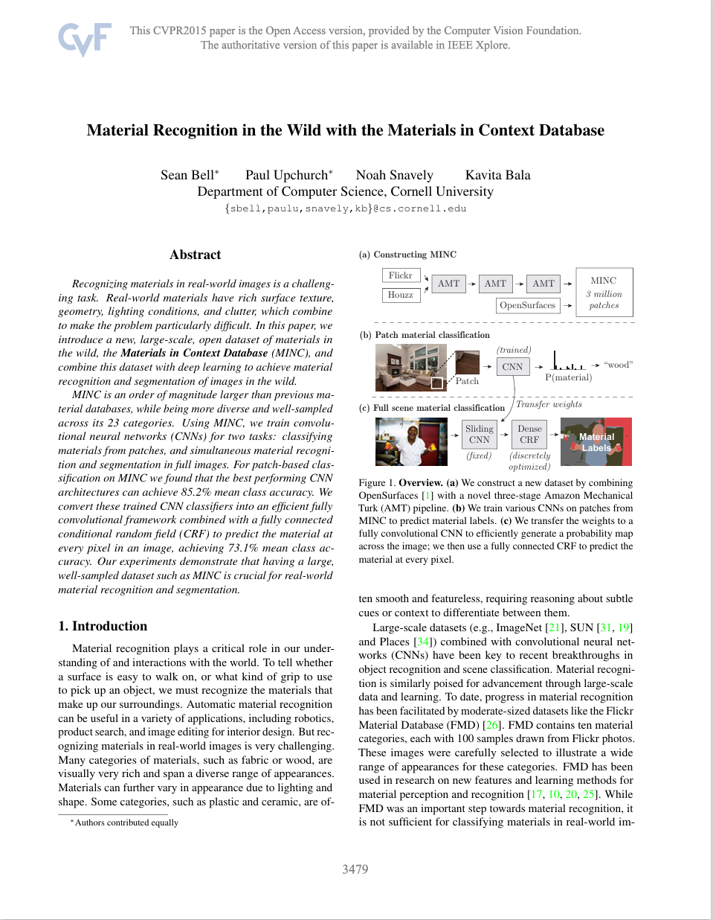
Material Recognition in the Wild with the Materials in Context Database
CVPR 2015
Cornerll University

Slide 3
Bell, Sean, et al. "Material recognition in the wild with the materials in context database." Proceedings of the IEEE conference on computer vision and pattern recognition. 2015.
Introduction
Material recognition plays a critical role in human understanding of and interactions with the world.
To tell whether a surface is easy to walk on, or what kind of grip to use to pick up an object, must recognize the materials that make up our surroundings.
Also, automatic material recognition can be useful in a variety of applications, including robotics, product search, and image editing for interior design.

Slide 4
Bell, Sean, et al. "Material recognition in the wild with the materials in context database." Proceedings of the IEEE conference on computer vision and pattern recognition. 2015.
Introduction
But it is very difficult to recognize materials in real images, as categories like fabric and wood have too many different appearances, while plastics and ceramics are too featureless.
To address these issues, the authors propose MINC, an image dataset containing approximately 3 million material samples in 23 categories..
Train a CNN architecture using the MINC dataset for material recognition.

Slide 5
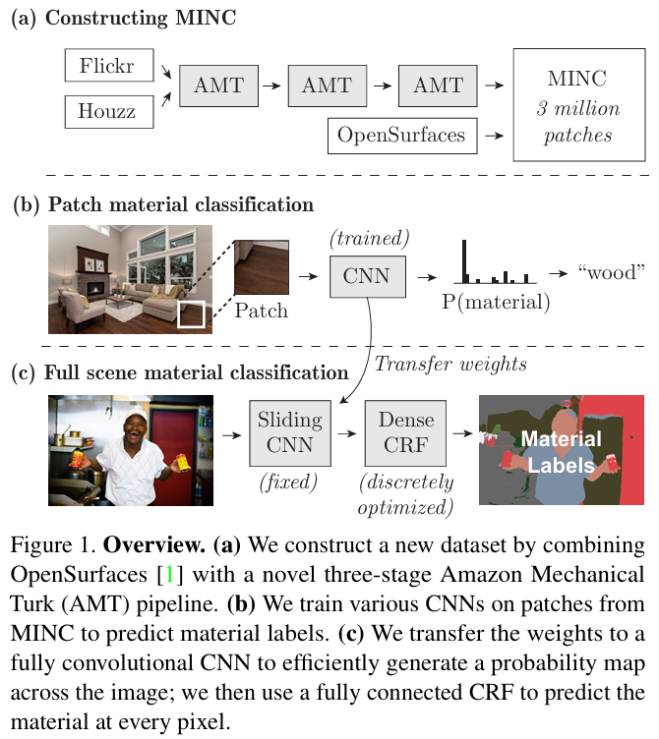
Bell, Sean, et al. "Material recognition in the wild with the materials in context database." Proceedings of the IEEE conference on computer vision and pattern recognition. 2015.
MINC Dataset

Slide 6

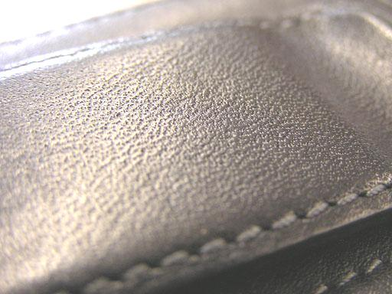
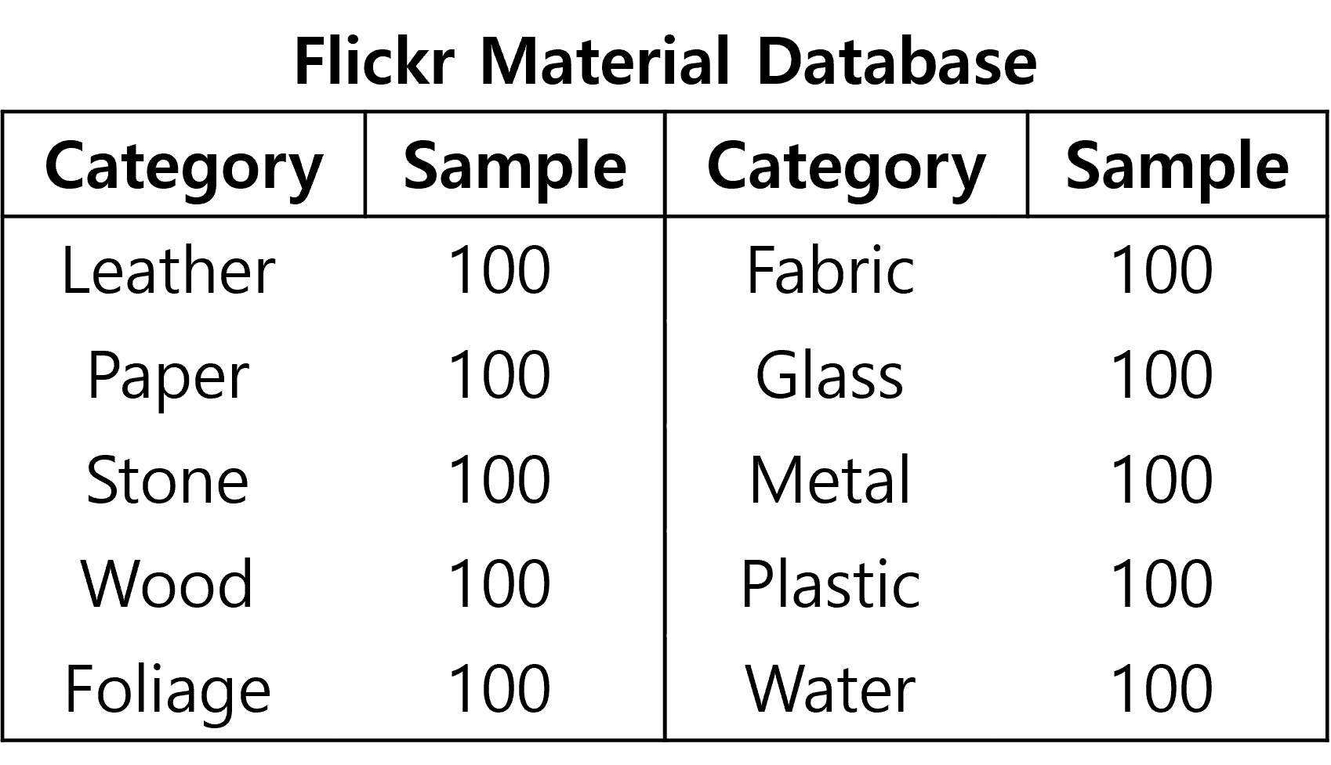
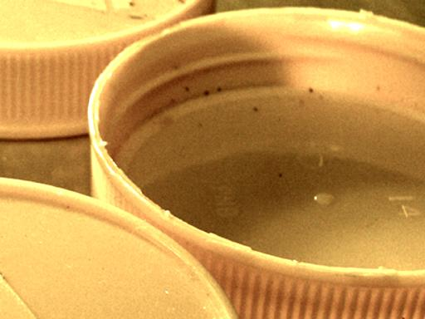
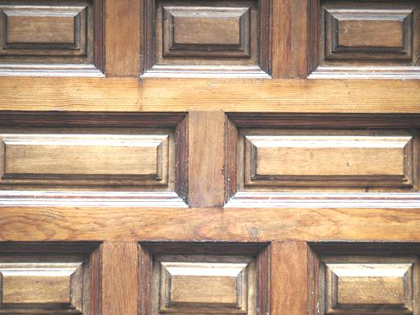

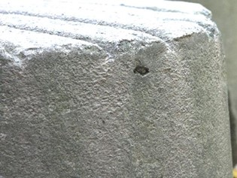
Bell, Sean, et al. "Material recognition in the wild with the materials in context database." Proceedings of the IEEE conference on computer vision and pattern recognition. 2015.
MINC Dataset
Flickr Material Database (FMD)
Metal
Leather
Plastic
Wood
Water
Stone

Slide 7

Bell, Sean, et al. "Material recognition in the wild with the materials in context database." Proceedings of the IEEE conference on computer vision and pattern recognition. 2015.
MINC Dataset
Houzz

Slide 8
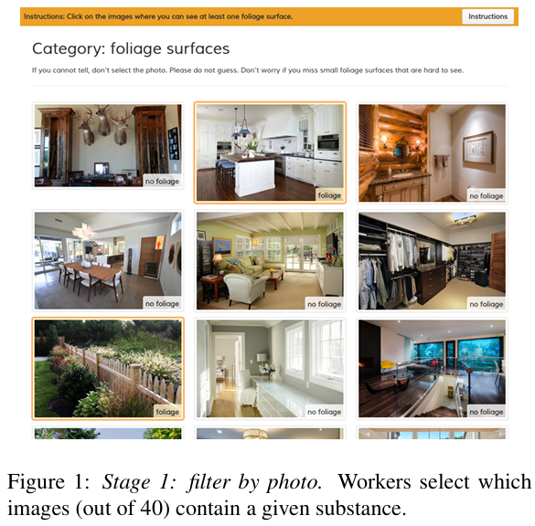
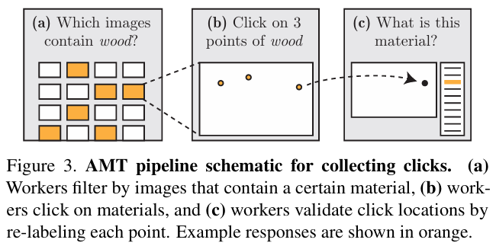
Bell, Sean, et al. "Material recognition in the wild with the materials in context database." Proceedings of the IEEE conference on computer vision and pattern recognition. 2015.
MINC Dataset
Amazon Mechanical Turk (AMT)

Slide 9
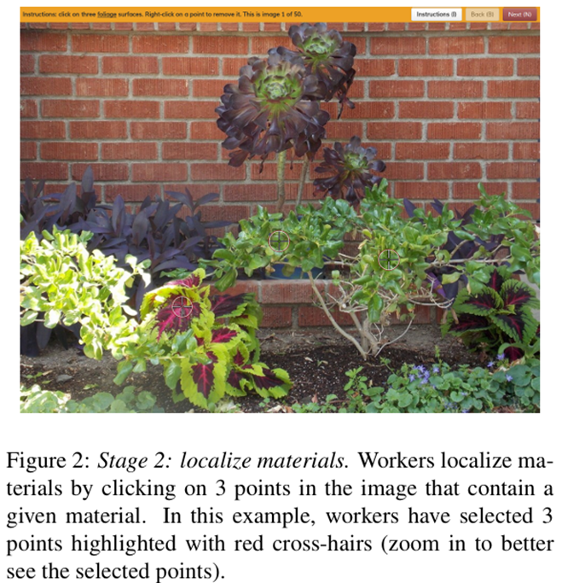
Bell, Sean, et al. "Material recognition in the wild with the materials in context database." Proceedings of the IEEE conference on computer vision and pattern recognition. 2015.
MINC Dataset
Amazon Mechanical Turk (AMT)

Slide 10
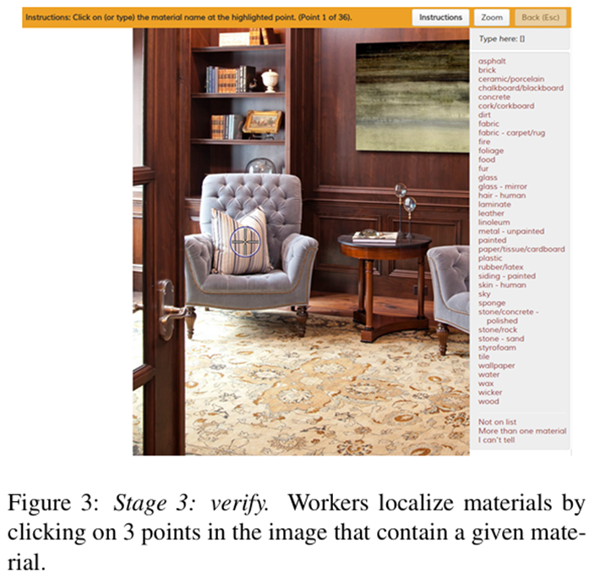
Bell, Sean, et al. "Material recognition in the wild with the materials in context database." Proceedings of the IEEE conference on computer vision and pattern recognition. 2015.
MINC Dataset
Amazon Mechanical Turk (AMT)

Slide 11
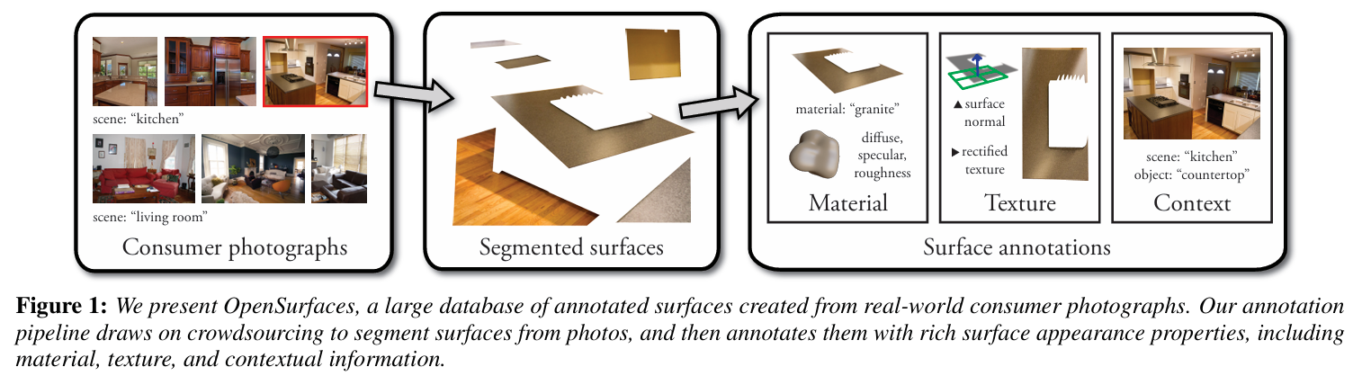
Bell, Sean, et al. "Material recognition in the wild with the materials in context database." Proceedings of the IEEE conference on computer vision and pattern recognition. 2015.
MINC Dataset
OpenSurfaces

Slide 12
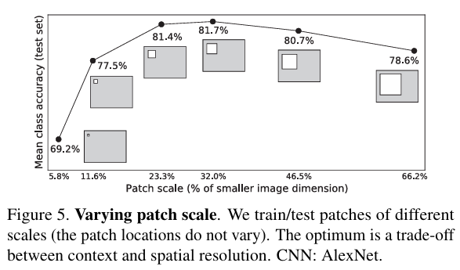
Bell, Sean, et al. "Material recognition in the wild with the materials in context database." Proceedings of the IEEE conference on computer vision and pattern recognition. 2015.
MINC Dataset

Slide 13
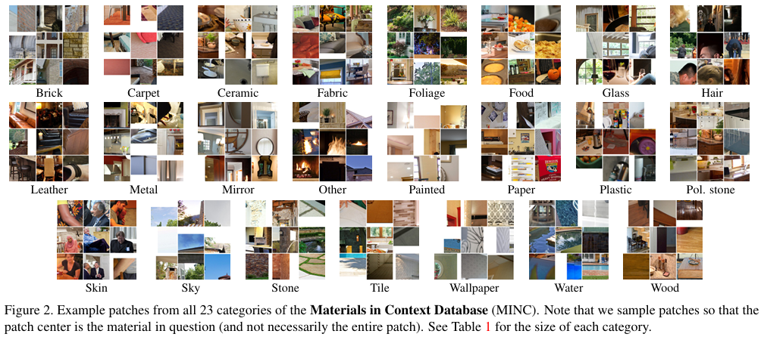
Bell, Sean, et al. "Material recognition in the wild with the materials in context database." Proceedings of the IEEE conference on computer vision and pattern recognition. 2015.
MINC Dataset

Slide 14
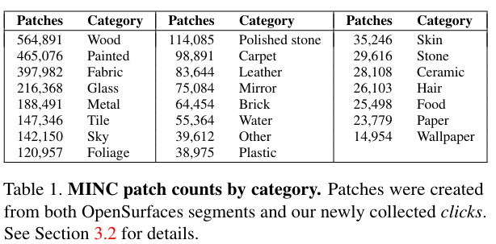
Bell, Sean, et al. "Material recognition in the wild with the materials in context database." Proceedings of the IEEE conference on computer vision and pattern recognition. 2015.
MINC Dataset
436,749 images -> 2,996,674 labeled patches

Slide 15
Bell, Sean, et al. "Material recognition in the wild with the materials in context database." Proceedings of the IEEE conference on computer vision and pattern recognition. 2015.
Material Recognition

Slide 16
Bell, Sean, et al. "Material recognition in the wild with the materials in context database." Proceedings of the IEEE conference on computer vision and pattern recognition. 2015.
Material Recognition

Slide 17
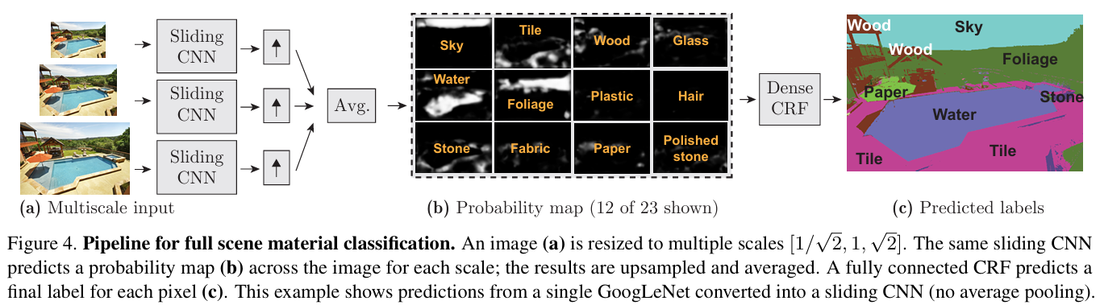
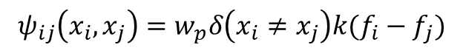

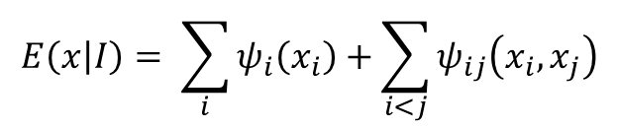
Bell, Sean, et al. "Material recognition in the wild with the materials in context database." Proceedings of the IEEE conference on computer vision and pattern recognition. 2015.
Material Recognition
Conditional Random Fields
$$E\left(x | I\right)= \sum_{i}{ψ_{i}\left(x_{i}\right)}+\sum_{i<j}{ψ_{ij}\left(x_{i},x_{j}\right)}$$
Unary term
$$ψ_{i}\left(x_{i}\right)=−\log{p_{i}}(x_{i})$$
Evaluates how appropriate a specific label is for each individual pixel.
Unary term
$$ψ_{ij}\left(x_{i},x_{j}\right)=w_{p}δ\left(x_{i}≠x_{j}\right)k(f_{i}−f_{j})$$
Evaluates how consistent and appropriate the labels are between adjacent pixels.

Slide 18
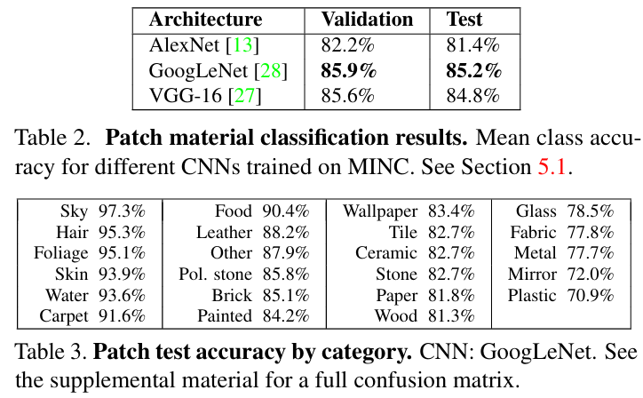
Bell, Sean, et al. "Material recognition in the wild with the materials in context database." Proceedings of the IEEE conference on computer vision and pattern recognition. 2015.
Experiments

Slide 19
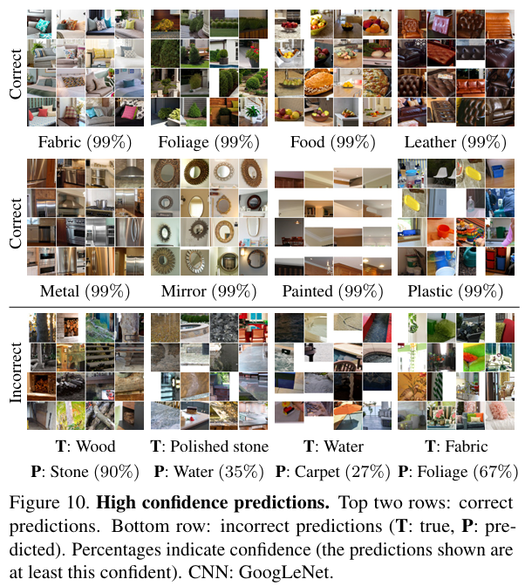
Bell, Sean, et al. "Material recognition in the wild with the materials in context database." Proceedings of the IEEE conference on computer vision and pattern recognition. 2015.
Experiments

Slide 20
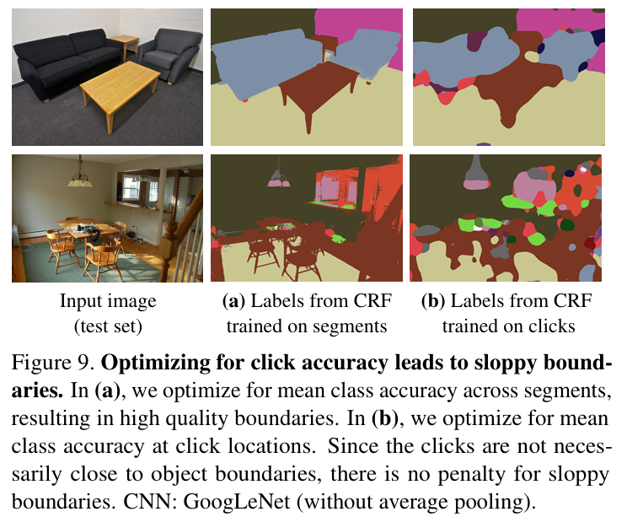
Bell, Sean, et al. "Material recognition in the wild with the materials in context database." Proceedings of the IEEE conference on computer vision and pattern recognition. 2015.
Experiments

Slide 21
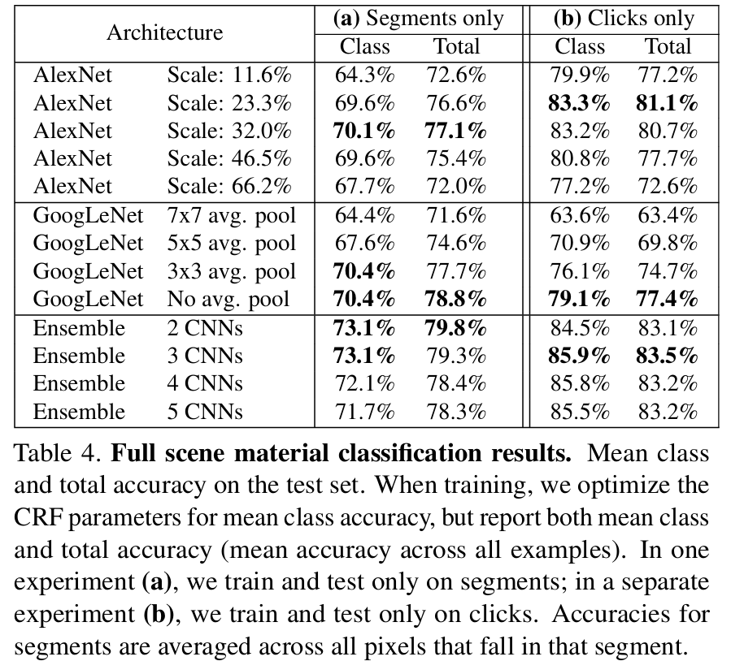
Bell, Sean, et al. "Material recognition in the wild with the materials in context database." Proceedings of the IEEE conference on computer vision and pattern recognition. 2015.
Experiments

Slide 22
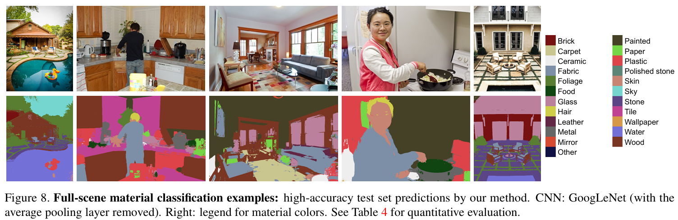
Bell, Sean, et al. "Material recognition in the wild with the materials in context database." Proceedings of the IEEE conference on computer vision and pattern recognition. 2015.
Experiments

Slide 23
Bell, Sean, et al. "Material recognition in the wild with the materials in context database." Proceedings of the IEEE conference on computer vision and pattern recognition. 2015.
Conclusion
Why I reviewed this paper?
I think that…
It is important to include material information when generating industrial image data.
I try to create a set of related sentences using Wordnet for material information, but the categories don't match: paper has material as a parent, but metal has element as a parent, which is not a material.
I wondered what it would be like to judge the material of an object by looking at its image, just as we can predict its material by looking at its image. ex) Bottle image = {Plastic}_{Bottle}
This paper follows a similar methodology, but it has an issue with not segmentation well.
So my idea is to use SAM to segment first, and then use the MINC dataset to learn about the material for the segmented parts.

Slide 24

Bell, Sean, et al. "Material recognition in the wild with the materials in context database." Proceedings of the IEEE conference on computer vision and pattern recognition. 2015.
Conclusion
CNN
Material_1_Segment
Material_1_mask
Material_1
SAM
Image
Segment Image
Material_2_mask
Material_2_mask
Material_2
Material_3_mask
Material_3_mask
Material_3

Slide 25
Thank you!

